Slide 1
Image-Based Steganography: Secure Message Encoding & Decoding Using OpenCV
CAPSTONE PROJECT
Presented By: GOPINATH K
Student Name : GOPINATH K
College Name & Department : M. KUMARASAMY COLLEGE OF ENGINEERING & ECE

Slide 2
OUTLINE
Problem Statement
Technology used
Wow factor
End users
Result
Conclusion
Git-hub Link

Slide 3
Problem Statement
A project on image-based steganography that deals with the secure hiding of messages into an image through pixel modification is investigated. The users can embed a secret message, and retrieval requires the correct passcode. Thus, ensuring confidentiality while making the image remain unchanged to the human visual system. This system is very simple and efficient to conceal and decode information without raising any suspicion.

Slide 4
Technology used
Libraries Used: OpenCV, OS, String (Python Standard Library)
Programming Language: Python
Platform: Windows (can be adapted for other OS)

Slide 5
Wow factors
1. Message Encoding by Pixel Sites: Directly change pixel values to imbue secret messages as much as natural with image.
2. Decryption with Password Protection: So that only authenticated users can retrieve the hidden messages, hence, adding an extra security layer.
3. Dictionary-Based Characters Mapping: Uses a dedicated encoding scheme outlining conversion of characters to pixel values, hence providing additional security and uniqueness.
5. Image Looks Normal: The encoded image will be innocuous-looking; less suspicious is the way against other cryptography techniques.
6. Lightweight and Platform Adaptable: Uses negligible resources and can be easily customized for other operating systems besides Windows.
7. Easy Implementing Mechanism: This is an easy-to-implement solution for secure communication as opposed to complex steganographic methods.

Slide 6
End users
1. Journalist and Activists: Secure communication in monitored environments without calling attention.
2. Cybersecurity Buff Enthusiasts and Ethical Hackers: Investigate and experiment with steganography for secure data transfer.
3. Government and Intelligence Agencies: Transfer classified information covertly without traditional encryption footprints.
4. Business Professionals and Corporations: Secure confidential data inside images for secure internal communication.
5. General Citizen and Privacy-Conscious Individuals: Hide personal or sensitive information in images for private sharing.
6. Educational Institution and Researcher: Teach and Learn in the course of Cryptography and Cybersecurity Courses.

Slide 7
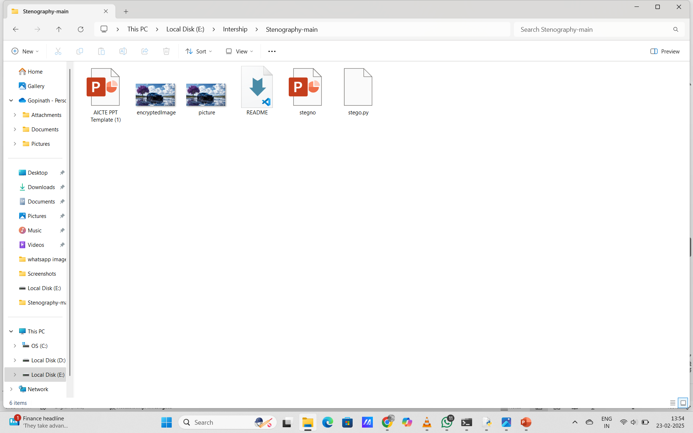
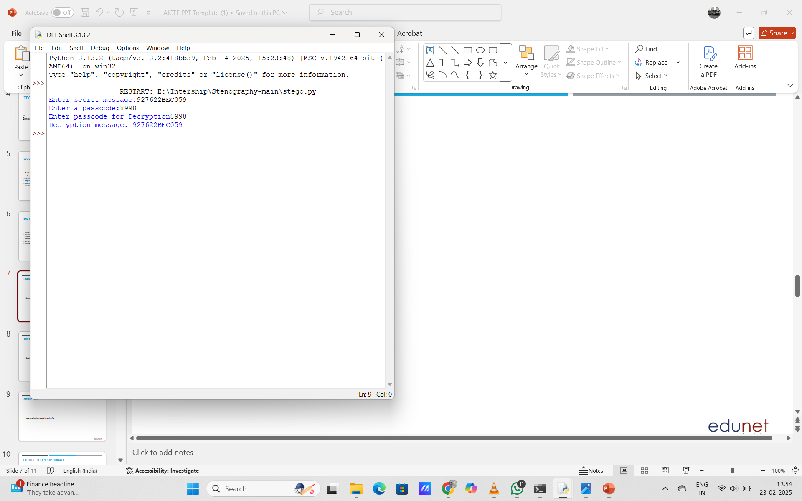
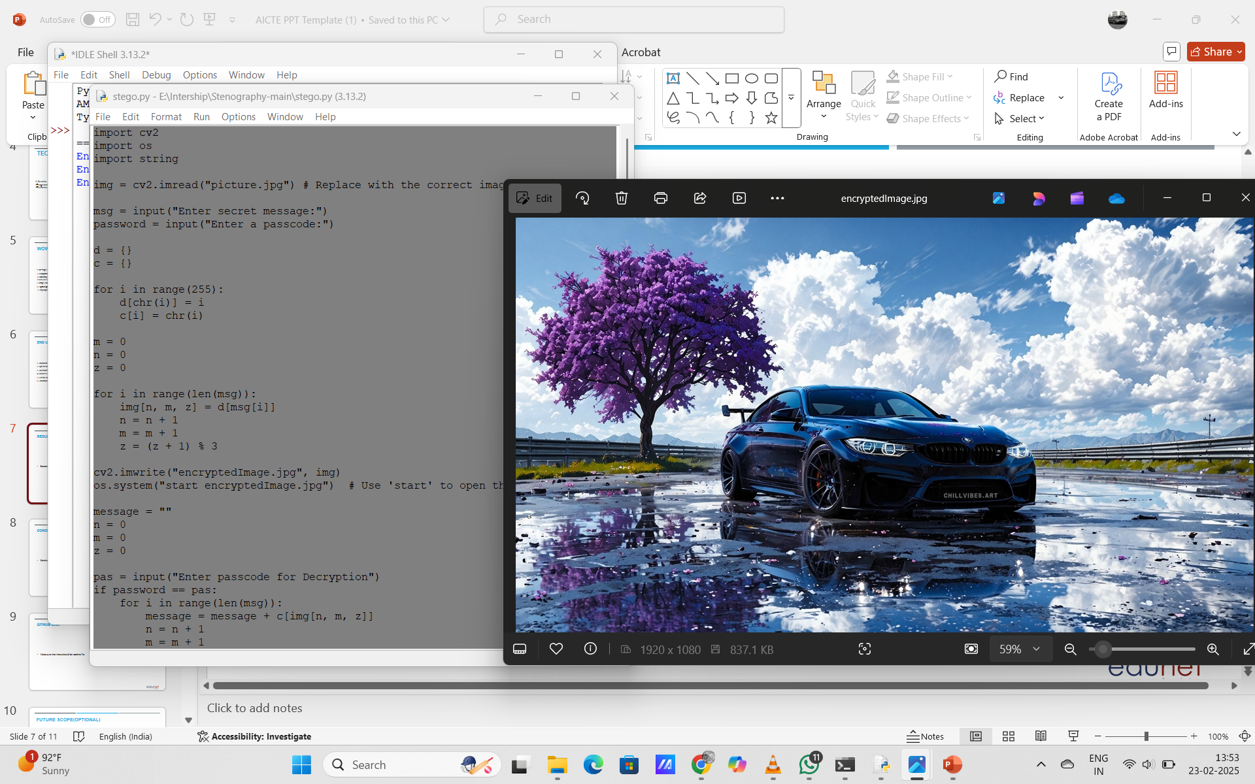
Results

Slide 8
Conclusion
This project has therefore successfully established image-based steganography as a safe method for hiding messages in images. By changing pixel values, it makes sure that sensitive information would be hidden away while keeping the image itself unchanged to sight. Encryption can only be done by an authorized user, thanks to password-protected decryption. With its lightweight and platform-independent solution, the system acts as a very effective and discreet way of transferring confidential data. The project thus takes a vital step toward secure communication by presenting a very straightforward yet effective alternative to standard encryption approaches.

Slide 9
GitHub Link
https://github.com/Gopinath-15/Image-Steganography---python

Slide 10
THANK YOU

